Slide 1
Milestone Three
Nick Abcarius
Andrew Do
Travis Garcia
Nicole Pavlovich
Steven Tan
UC Davis, ECS 165A
Prof Mohammad Sadoghi
Notes:
Nicole

Slide 2
Milestone Goals
Implement a lock manager to protect records during transactions and latches to protect shared data structures
Implement concurrency through multithreaded transactions
Be able to roll back aborted transactions to ensure data integrity
Notes:
Nicole

Slide 3
Locks & Latches

Slide 4
Locks
Lock Policy
Two-Phase Locking (2PL) with no wait: if a transaction can’t obtain a lock, it immediately aborts
Locking occurs at the record level
Implementation
The lock manager is implemented at a global level
Contains a dictionary mapping record keys to lock objects
Transactions have an ID which determines if multiple writes or reads can happen on the same record by a single transaction
class RecordLock():
def __init__(self):
self.sLocks = 0
self.xLocks = 0
self.isShrinking = False
self.inUseBy = []
class LockManager():
def __init__(self):
self.latch = threading.Lock()
self.KeytoLocks = {}
self.transactionID = -1
def getTransactionID(self)
def obtainSLock(self, Key, transactionID)
def obtainXLock(self, Key, transactionID)
def giveUpSLock(self, Key, transactionID)
def giveUpXLock(self, Key, transactionID)
Notes:
Travis
shrinking covered in threading slide
Reference the actual code
Locking record instead of page avoids many aborts

Slide 5
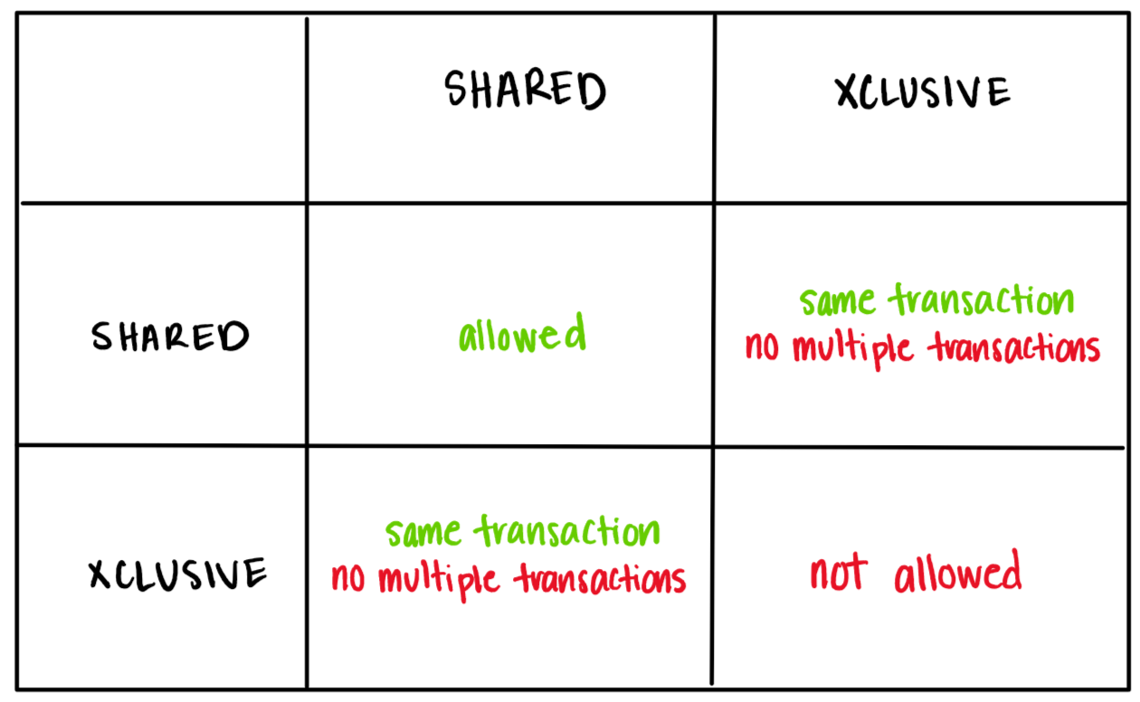
Locks & Latches
Rules for Locking
Latching
Shared data structures are latched so that data integrity is ensured with concurrent access
Used to prevent race conditions from non-atomic operations such as accessing the bufferpool or index updates
Implemented using the Lock object from threading module (self.latch = threading.Lock())
Notes:
Nicole
When the lock manager decides whether to allow a lock, it must follow the rules for locking
The same transaction is allowed to have both S and X locks on the same record, but if the transaction IDs are different this cannot be allowed
However, multiple transactions can have an S lock on a record as long as there are no exclusive locks
In addition to locking the record, we implemented latching on the bufferpool, index, lock manager, and math-based page directory because these structures might be used by multiple transactions.
We implemented it using the python threading lock object inside the lockManager class
We want to avoid evicting a page that is in use, for instance, or from creating duplicate new RIDs for inserted records

Slide 6
Threading

Slide 7
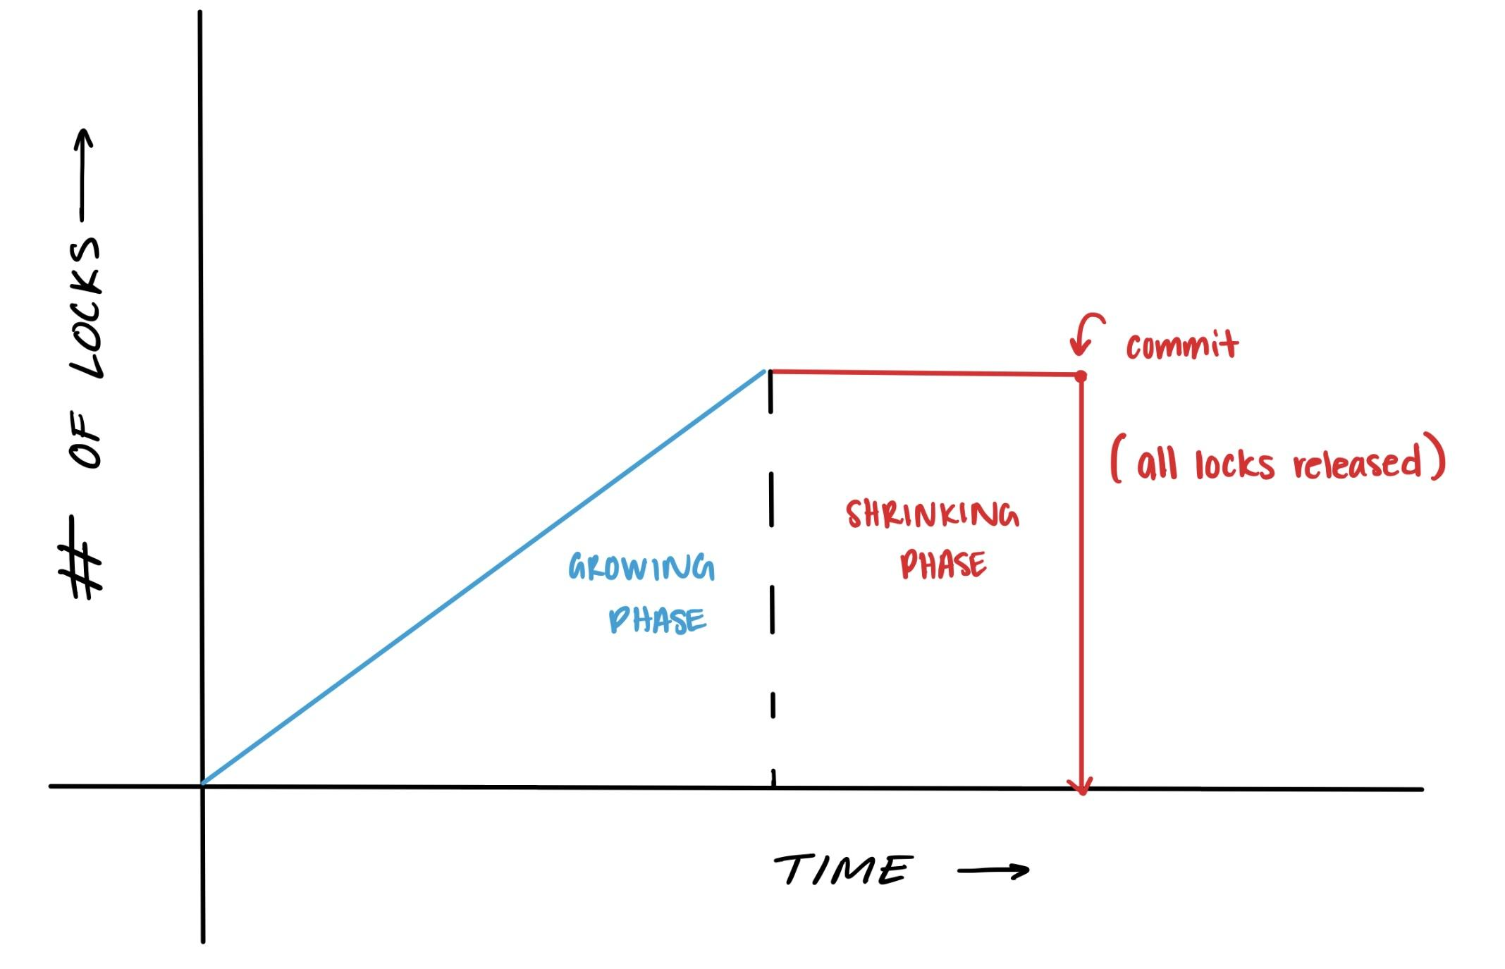
Threading
Implementing threading must be done carefully without breaking the promises of ACID:
Atomicity: A transaction fails or finishes, but never partially
Consistency: Only valid data is written to the database
Integrity: Concurrent transactions execute in an order than can be sequentialized
Durability: Changes are saved in non-volatile memory
Threads are represented by the transaction_worker class. We instantiated 8 threads for testing
Notes:
Andrew
Talk about the growing/shrinking of a transaction
Because of the Lock Manager and the latching of shared data structures, we are able to handle several transactions running concurrently on multiple threads.
This means that we can have several transactions reading the same record at the same time without having to worry about a writer changing the information.
In other words, our threading doesn’t have to worry about a readers - writers problem.

Slide 8
Commits

Slide 9
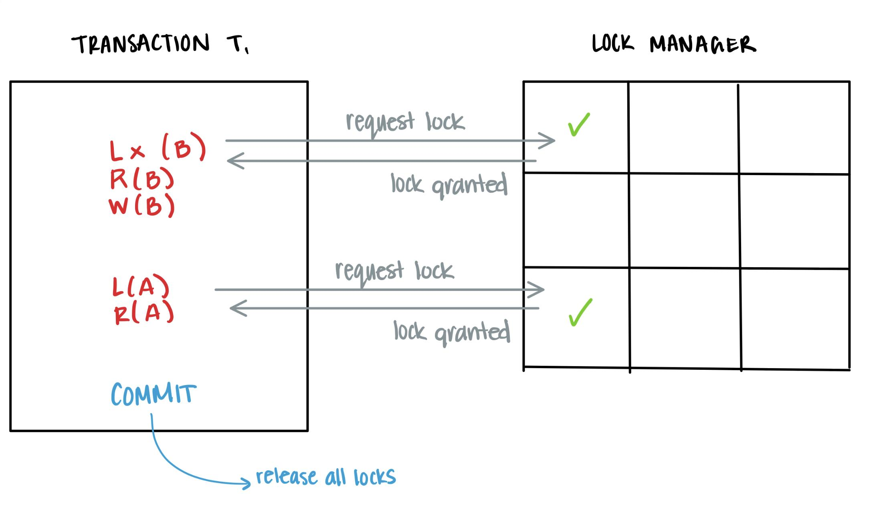
Commits
Once a transaction successfully completes all of its queries, the changes are committed to the database
Step 1: Commit Records
Acquire a latch, then update the key mapping in our table to point to the committed base RID so that the record is now visible
Update the base indirection value so the tail record is now visible
Step 2: Release all locks
For each query in the transaction, depending on its type, X or S locks are released and the latch is released
Committed transactions then return True
Notes:
Steven

Slide 10
Aborts

Slide 11
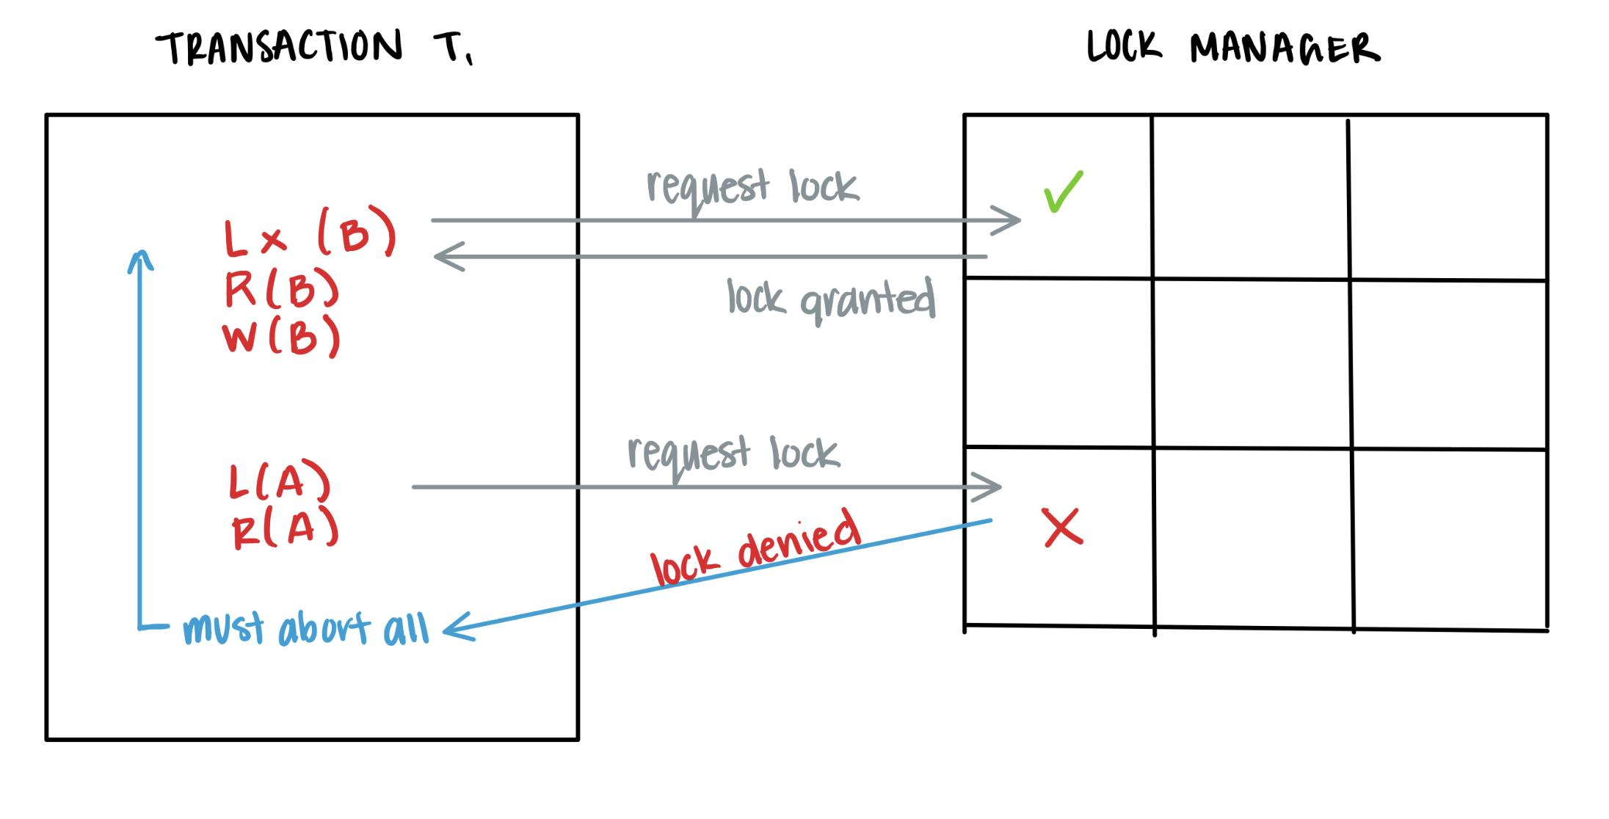
Aborts
In order to maintain atomicity, a transaction that fails to completely execute must be aborted
Step 1: Rollback Changes
Delete any inserted tail or base records
Step 2: Release all locks
For each query in the transaction, depending on its type, X or S locks are released
Aborted transactions then return False
Notes:
Nick
To make sure our database is atomic, we will can abort transactions that can’t acquire all the locks it needs on records.
To do this, we simply need to rollback our changes and release all of our locks.
When we roll back our changes, we just delete any inserted records.
This means for inserts, we will invalidate the base page records inserted and for updates, we invalidate any the tail page records added.
When we release the locks, we simply loop through a list of the locks that the transaction acquired and remove those locks.
Queries that inserted or updated records will release X locks and queries the just read records will release S locks. If the transaction is successfully aborted, it will return false and the entire transaction will be discarded.

Slide 12
Final Thoughts
Durability could be increased as we currently can roll back aborts but have no formal log for crash protection
Implementation could switch from 2PL to 2VCC to avoid aborts
Could do further optimization and testing to improve overall performance
Notes:
Travis
exclusive locks start as shared locks (layering of locks)
have a lock queue so transactions that don’t receive a lock will wait in queue
certify phase: turn shared locks into x locks for commit
One problem we fixed: we tried to implement latching after implementing threading
One thing changed: going from semaphores to the threading.lock class
Had to figure out where to put our join (needed to be placed before the tester finished)
Design choice: transaction ID to execute locking object
Lock manager implemented at the global, which is BAD allowed because of the key system

Slide 13
Milestone Three
Nick Abcarius
Andrew Do
Travis Garcia
Nicole Pavlovich
Steven Tan
UC Davis, ECS 165A
Prof Mohammad Sadoghi
Notes:
Duplicate records can be inserted but only one is committed and tracked. The rest are essentially a memory leak?
Duplicate inserts: we put a lock on the record

